Slide 1
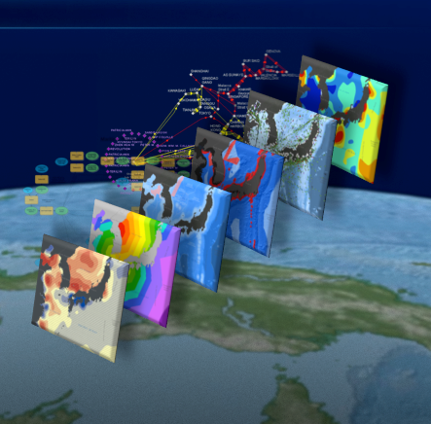

April 11th, 2016
Multi-scale Analysis of Surface-adjusted Geographic Distance
Andrew Eaman
Meg Brantley
Mehran Ghandehari
Geography Department

Slide 2

Geographic Distance
1- Planar distance 2- Geodesic distance 3- Pixel to pixel 4- Partially surface adjusted
Closest
TIN
Natural Neighbor
Weighted average
5- Complete surface adjusted (Proposed method)
Bi-linear
Bi-cubic
Bi-quadratic

Slide 3
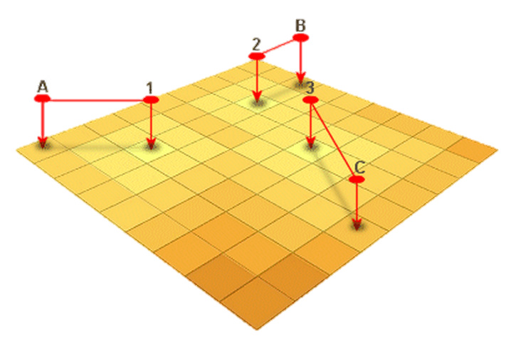
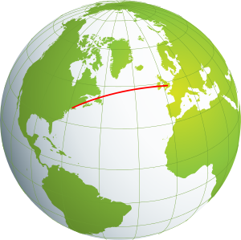
Geographic Distance
Planar distance (2D)
Geodesic distance (3D)

Slide 4
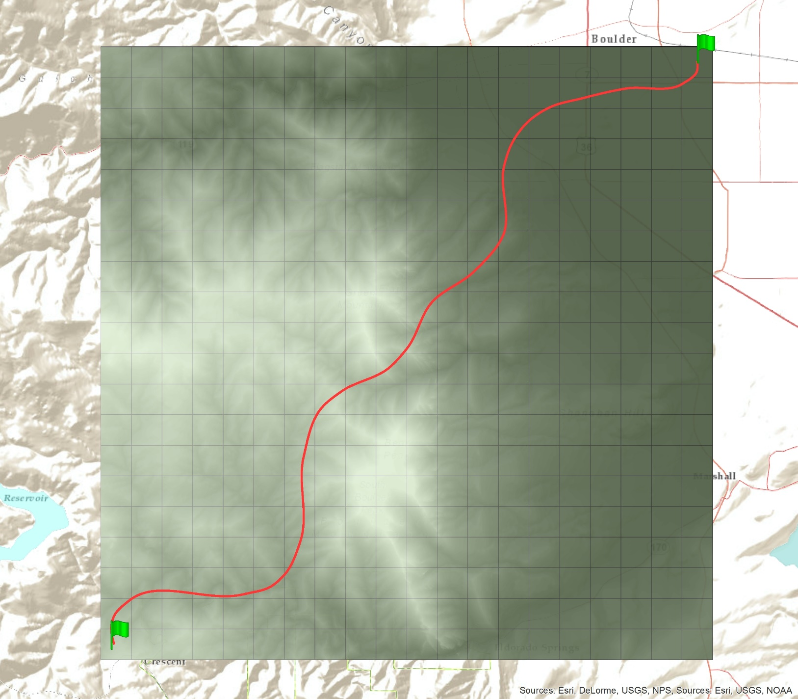
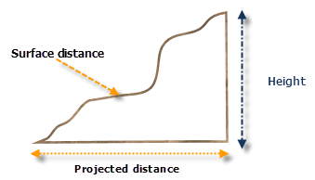
Surface-adjusted distance

Slide 5
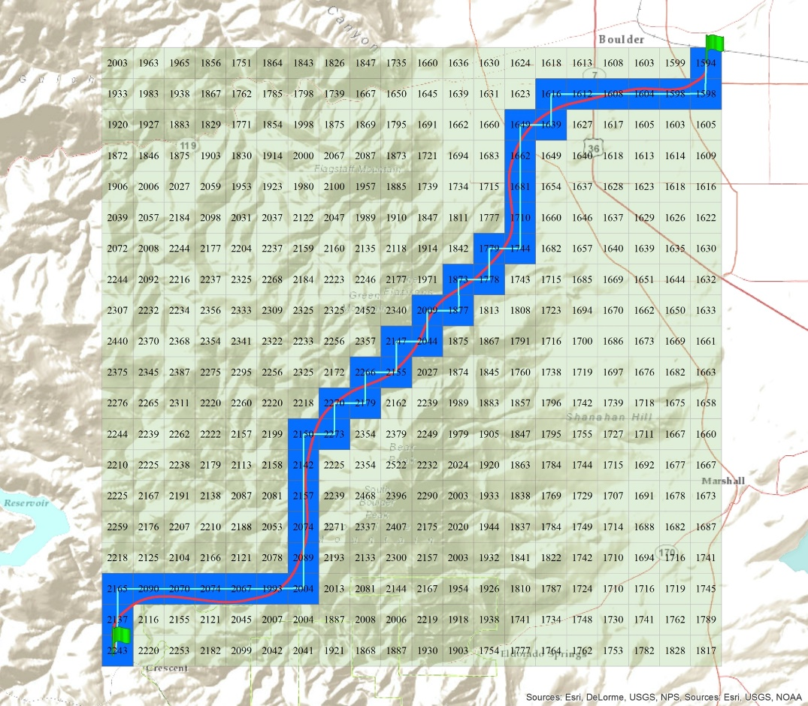
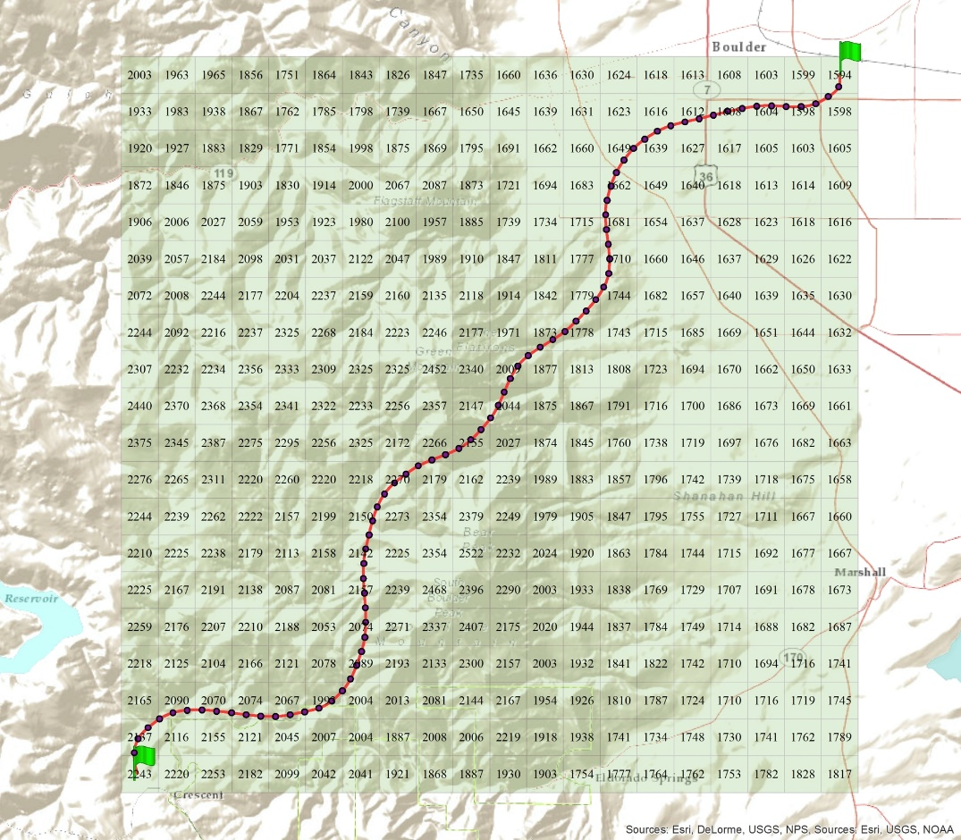

Surface-adjusted distance
Pixel 2 Pixel
Sample-based

Slide 6
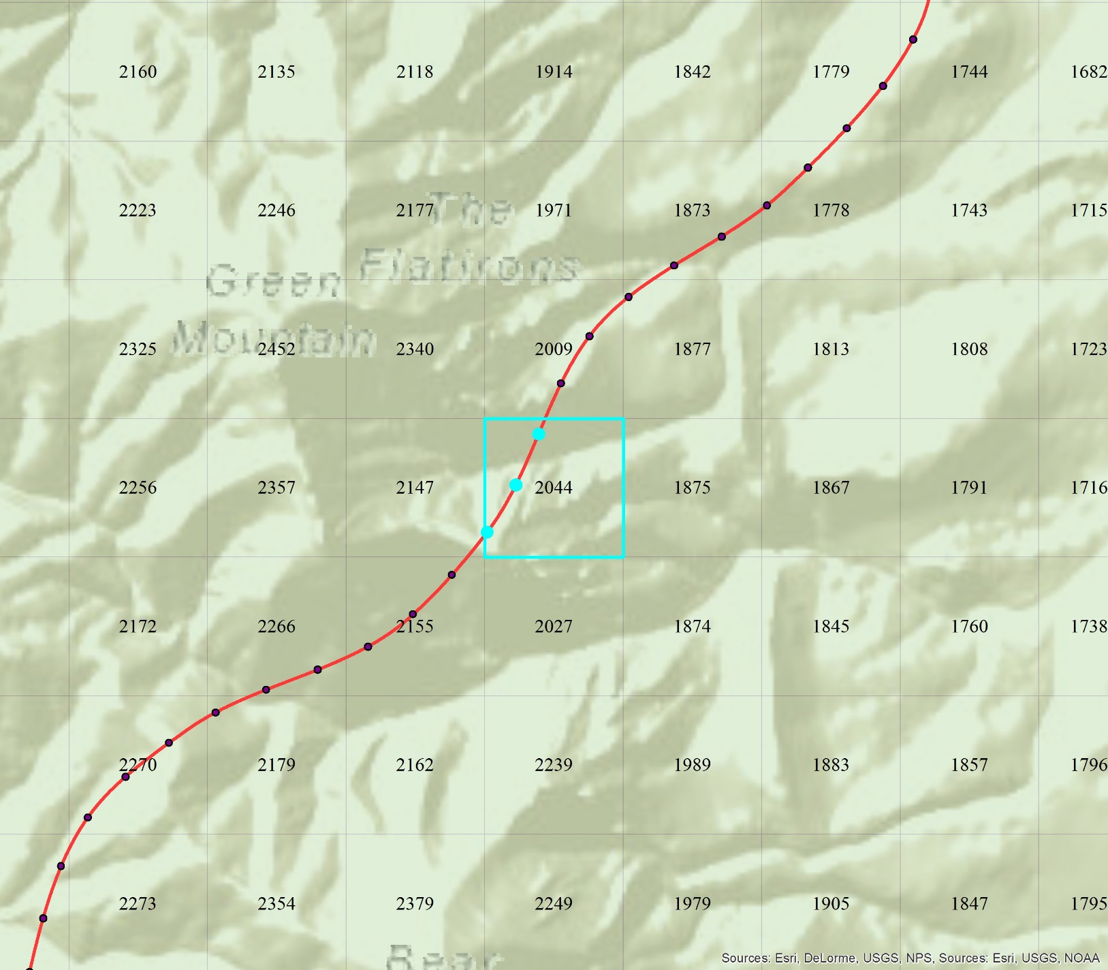
Closest

Slide 7
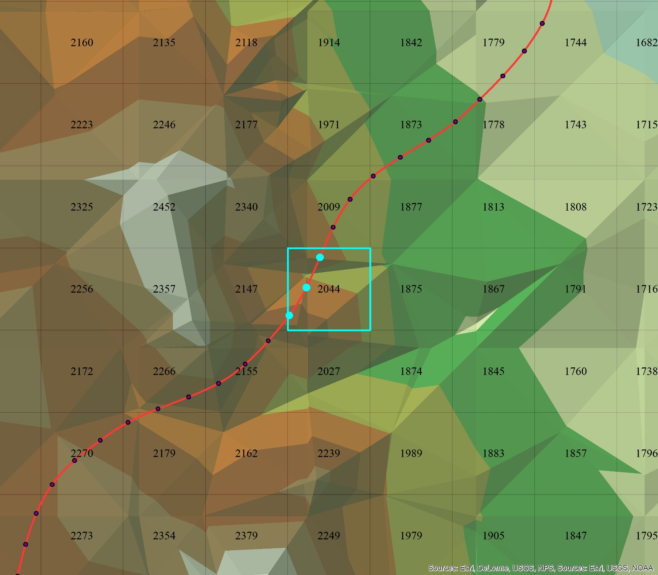
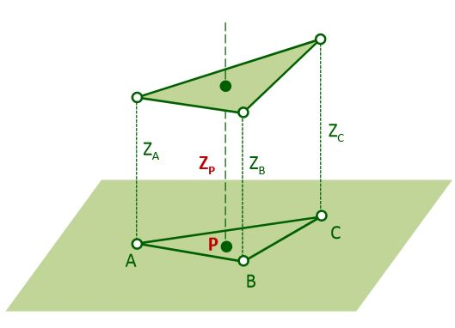
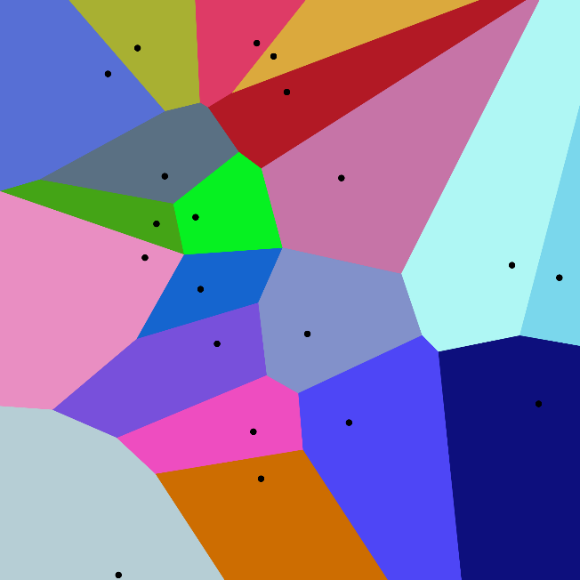
TIN and Natural Neighbor

Slide 8
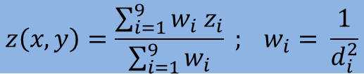
Weighted Average
$$z\left(x,y\right)=\frac{\sum_{i=1}^{9}{w_{i}{ z}_{i}}}{\sum_{i=1}^{9}{w_{i}}} ; w_{i}= \frac{1}{d_{i}^{2}}$$
Notes:
https://www.e-education.psu.edu/geog486/node/1877

Slide 9
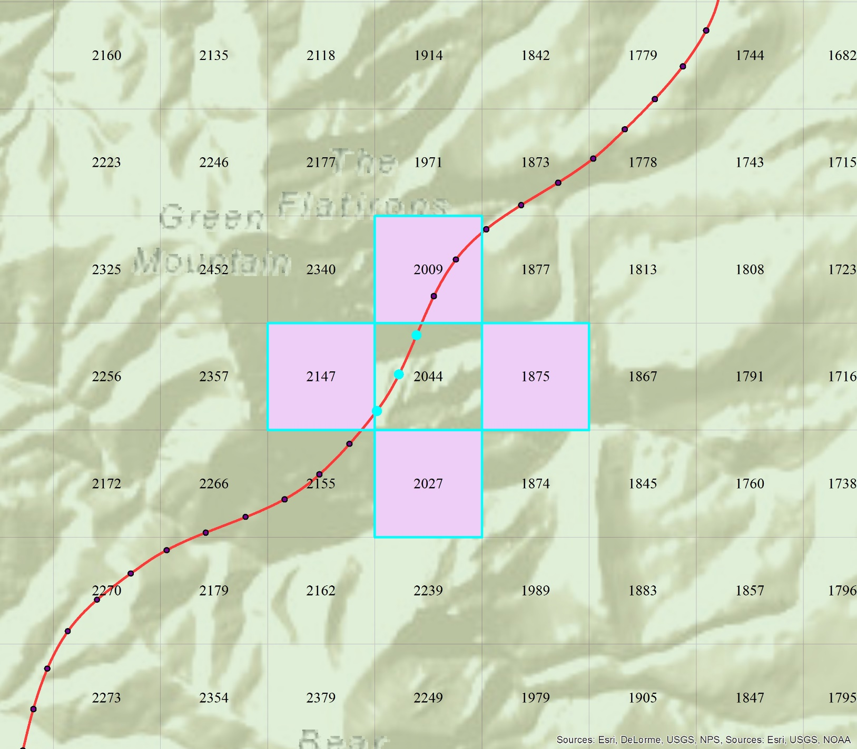
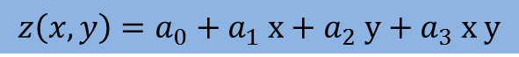
Bi-Linear
$$z\left(x,y\right)=a_{0}+a_{1} x+a_{2} y+a_{3} x y$$
Notes:
http://www.spatialanalysisonline.com/HTML/index.html?inverse_distance_weighting_idw.htm

Slide 10
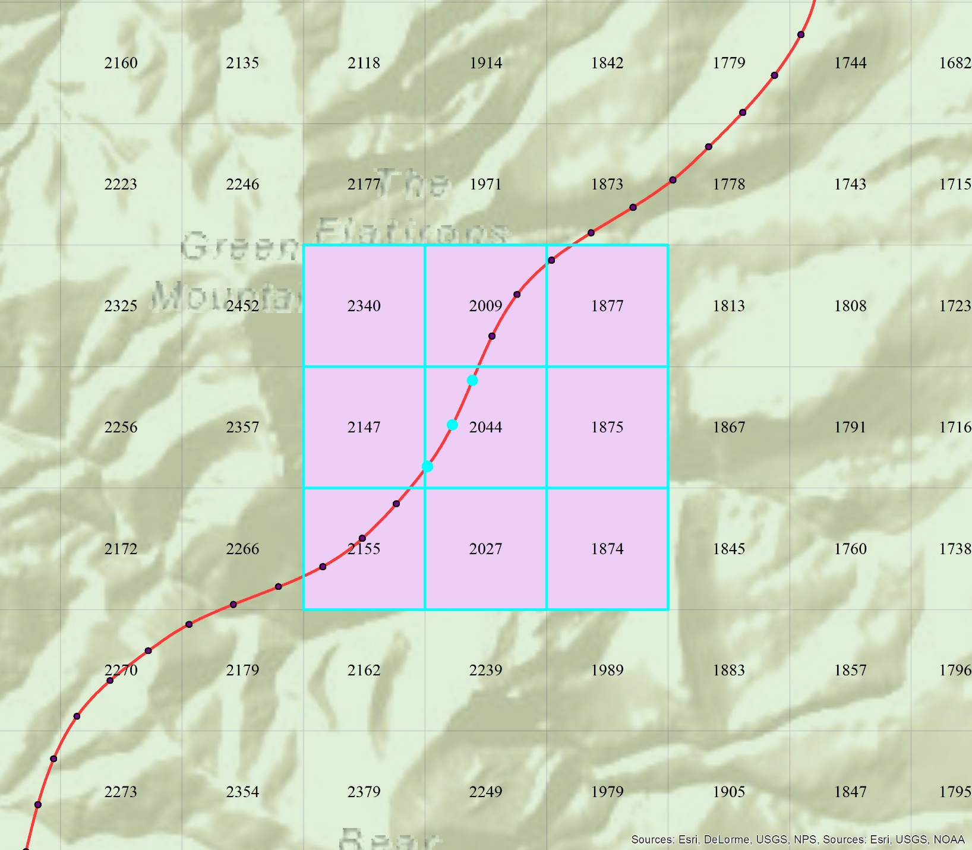
Bi-Quadratic
$z\left(x,y\right)=a_{0}+a_{1} x+a_{2} y+a_{3} x y+a_{4} x^{2}+a_{5} y^{2}+a_{6} x^{2}y^{2}+a_{7} x^{2} y$ $+a_{8} xy^{2}$

Slide 11
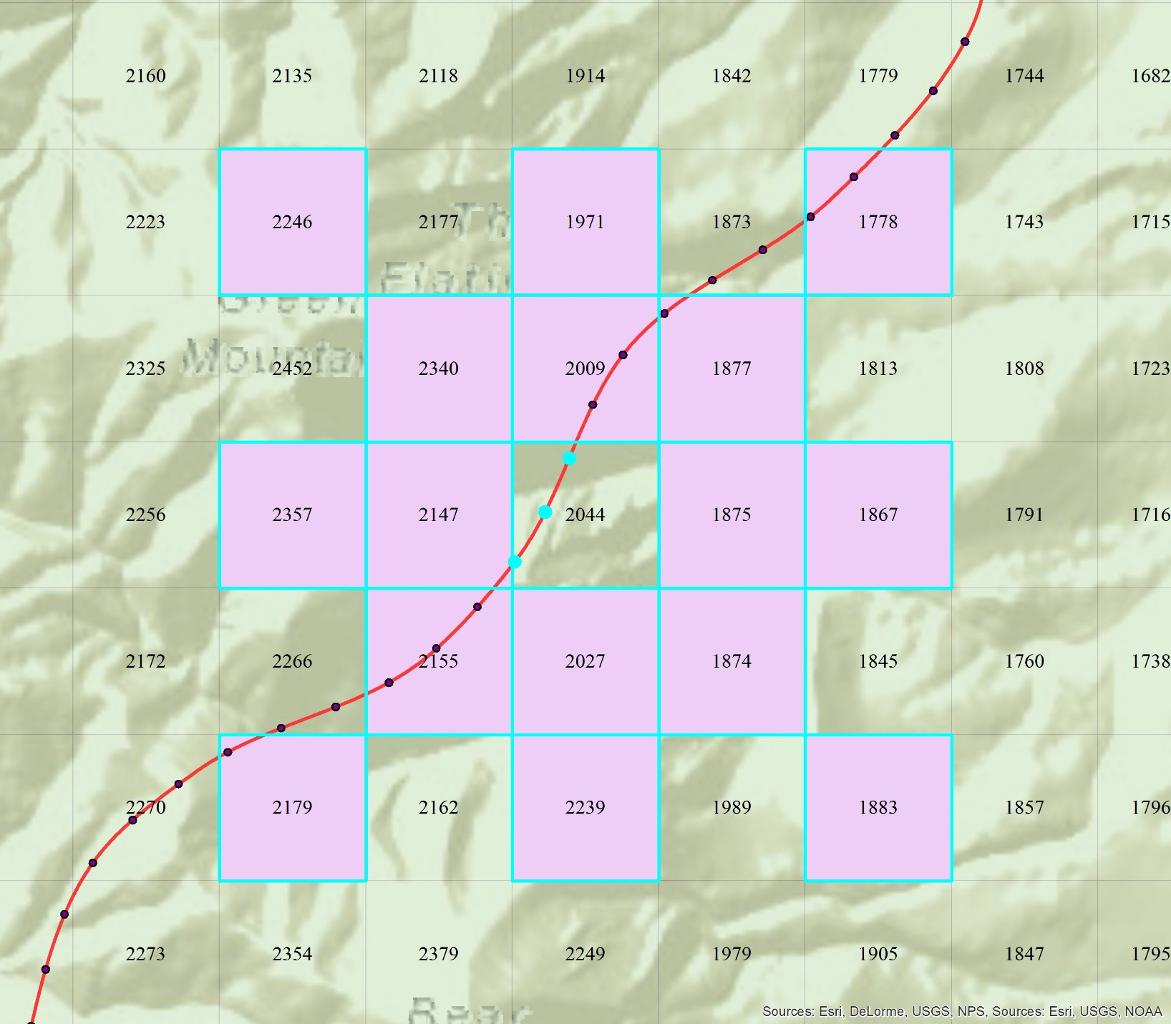
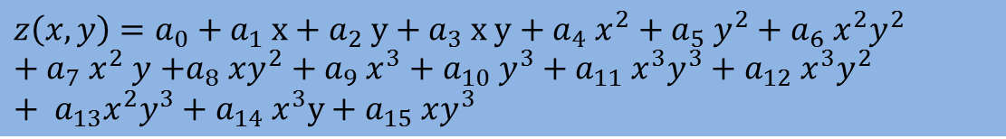
Bi-Cubic
$z\left(x,y\right)=a_{0}+a_{1} x+a_{2} y+a_{3} x y+a_{4} x^{2}+a_{5} y^{2}+a_{6} x^{2}y^{2}+a_{7} x^{2} y$ $+a_{8} xy^{2}+a_{9} x^{3}+a_{10} y^{3}+a_{11} x^{3}y^{3}+a_{12} x^{3}y^{2}+ {a_{13}x}^{2}y^{3}+a_{14} x^{3}y+a_{15} xy^{3}$

Slide 12
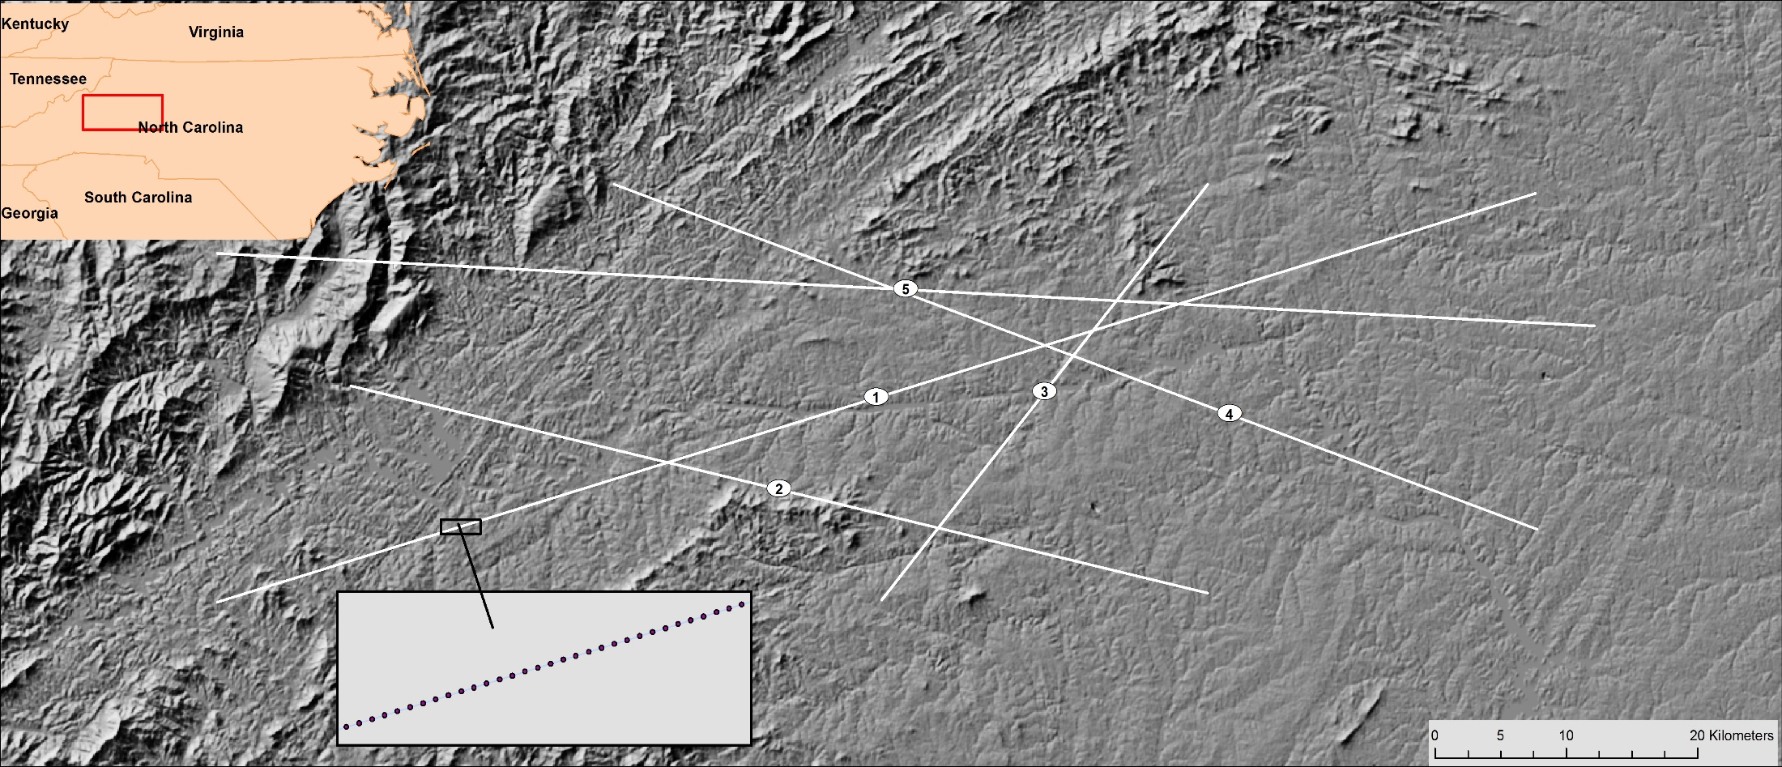
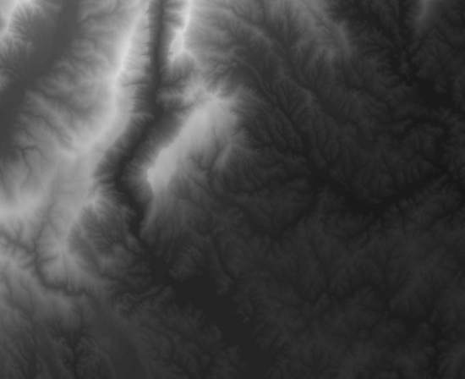
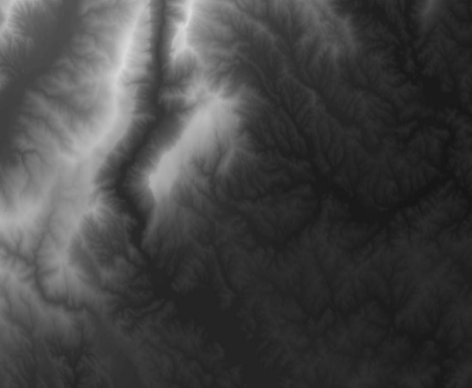
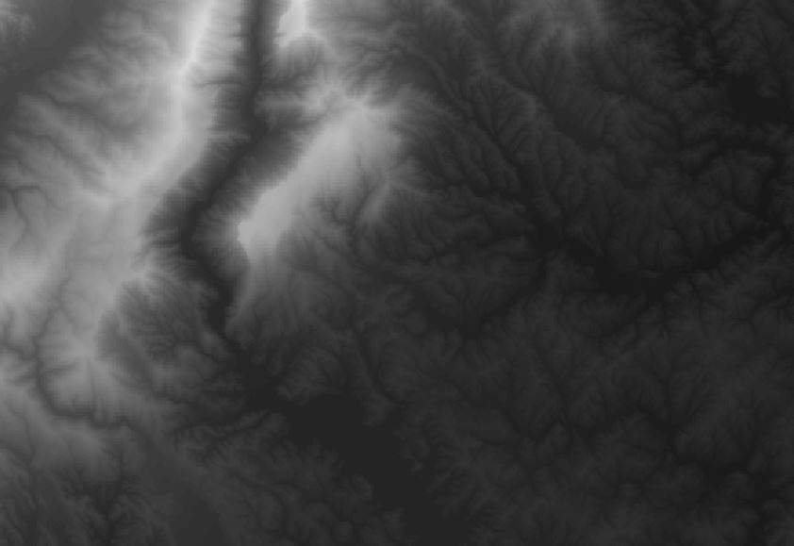
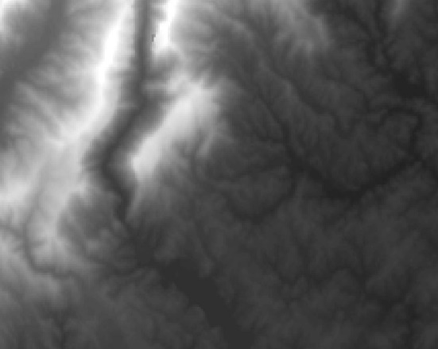


Dataset an Study Area
3m
10m
30m
100m
1000m
5000m

Slide 13
Code
Require: DEMs, Transects
For all Transects do
Module1(create samples)
For all DMEs(resolutions) do
Module2(Surface Adjusted Distance)
Function1(Pixel 2 Pixel)
Function2(Arc "Add surface information" tool)
Function3(Sample-based methods)
Module3(Inverse Distance Weighting)
Module4(Polynomial Interpolation)
End For
End For

Slide 14
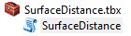
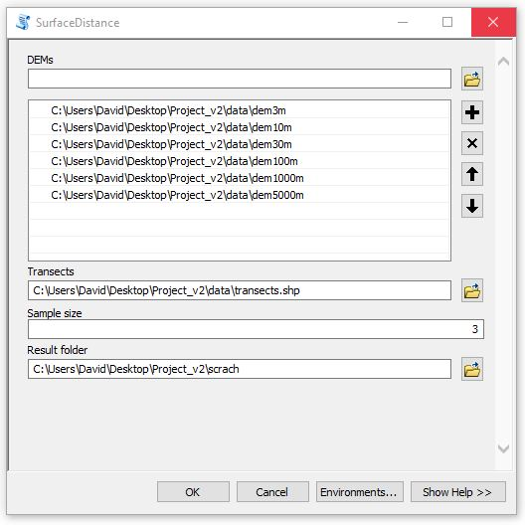
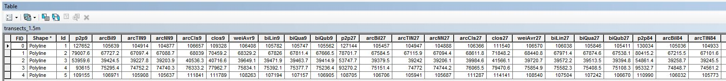
Toolbox

Slide 15
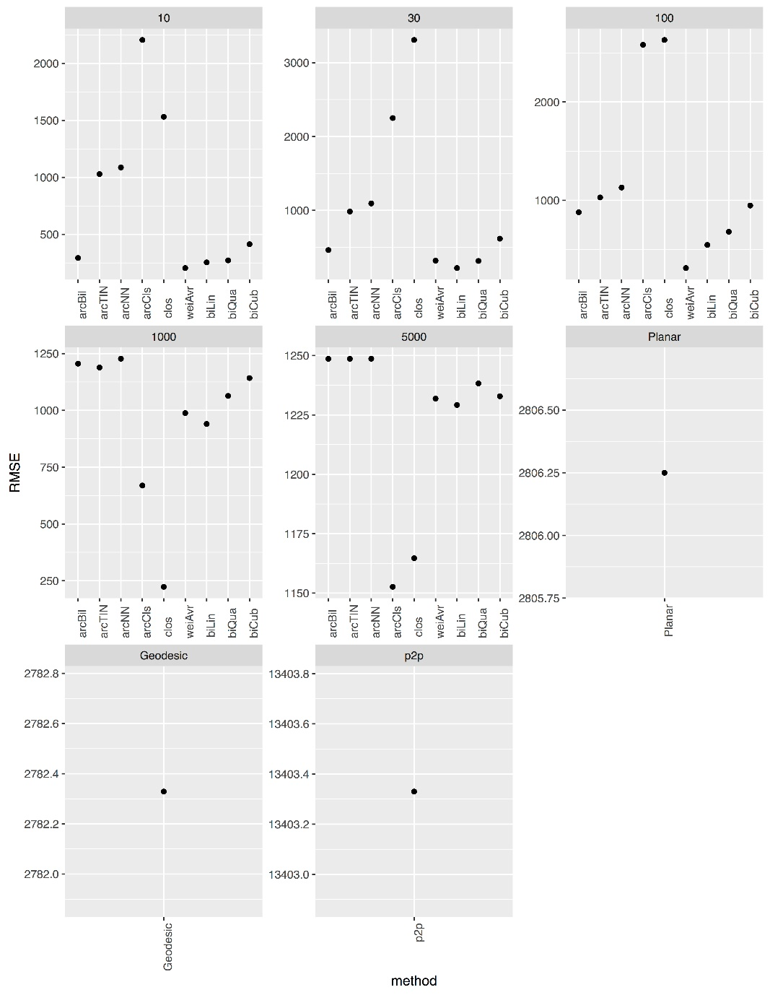
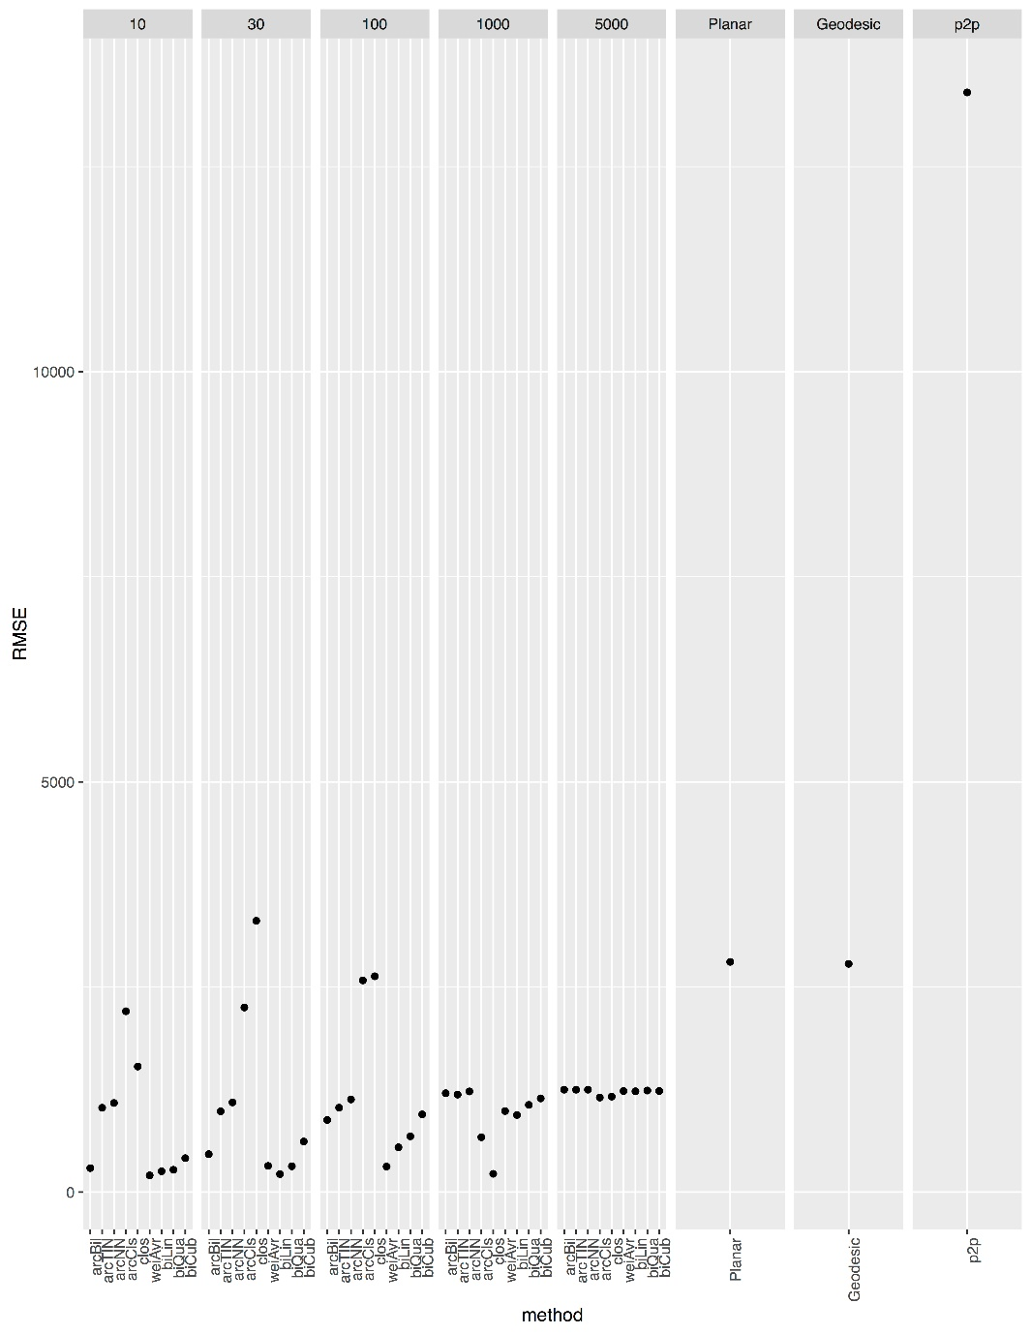
Results and Discussion

Slide 16
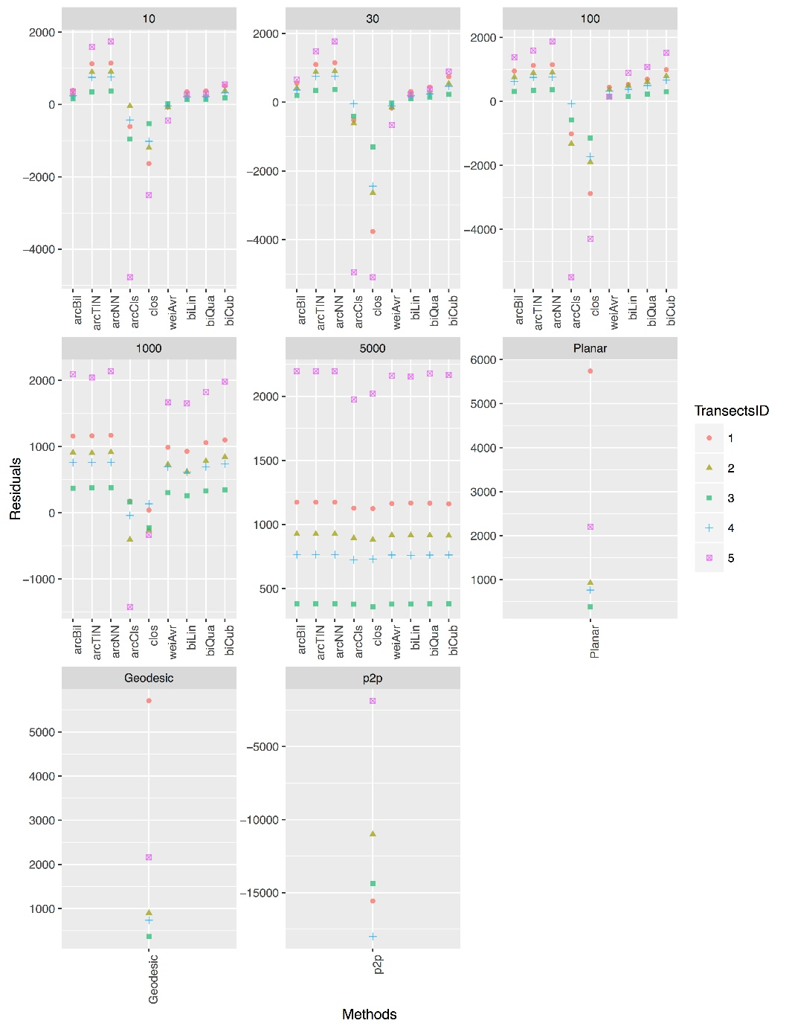
Results and Discussion

Slide 17
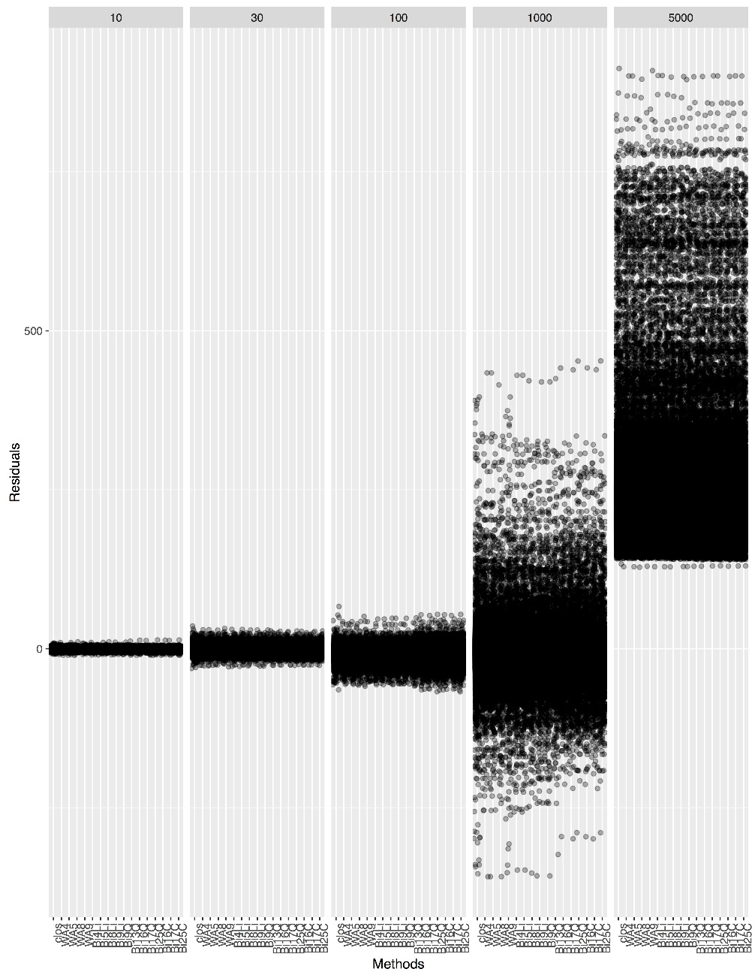
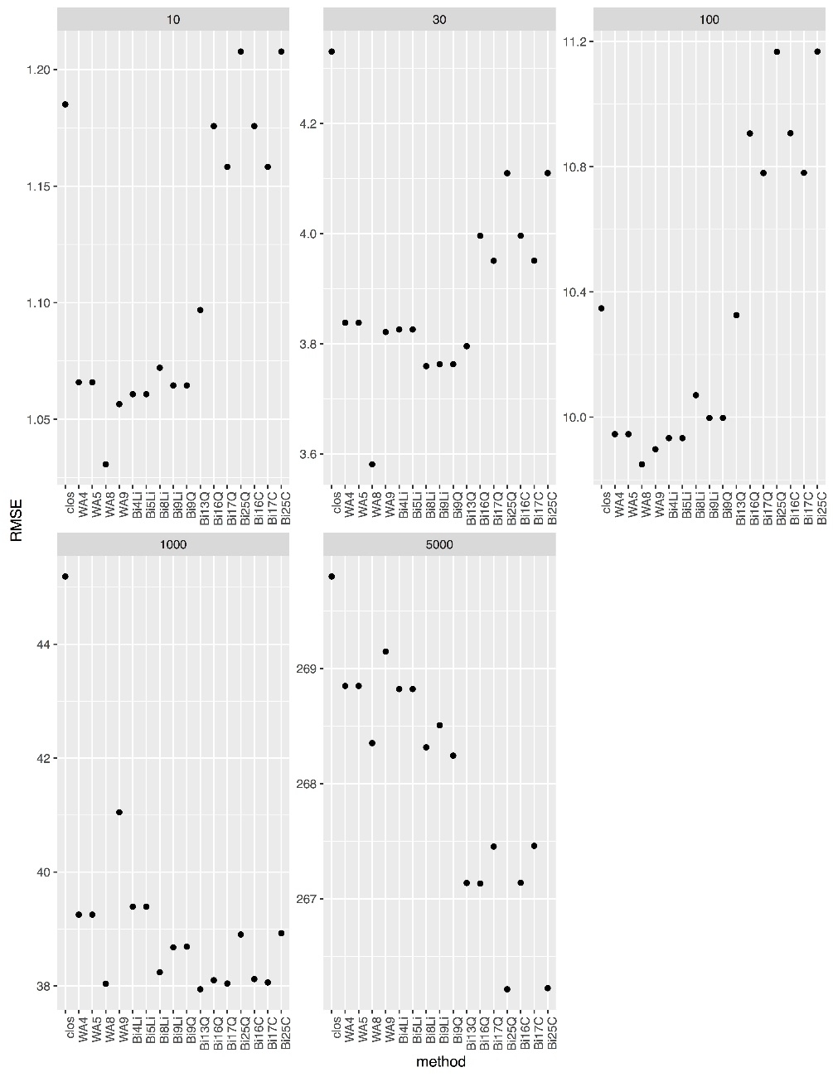
Results and Discussion

Slide 18
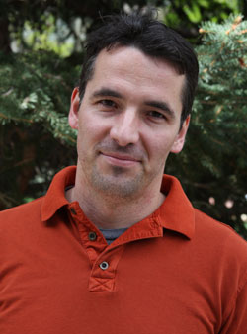
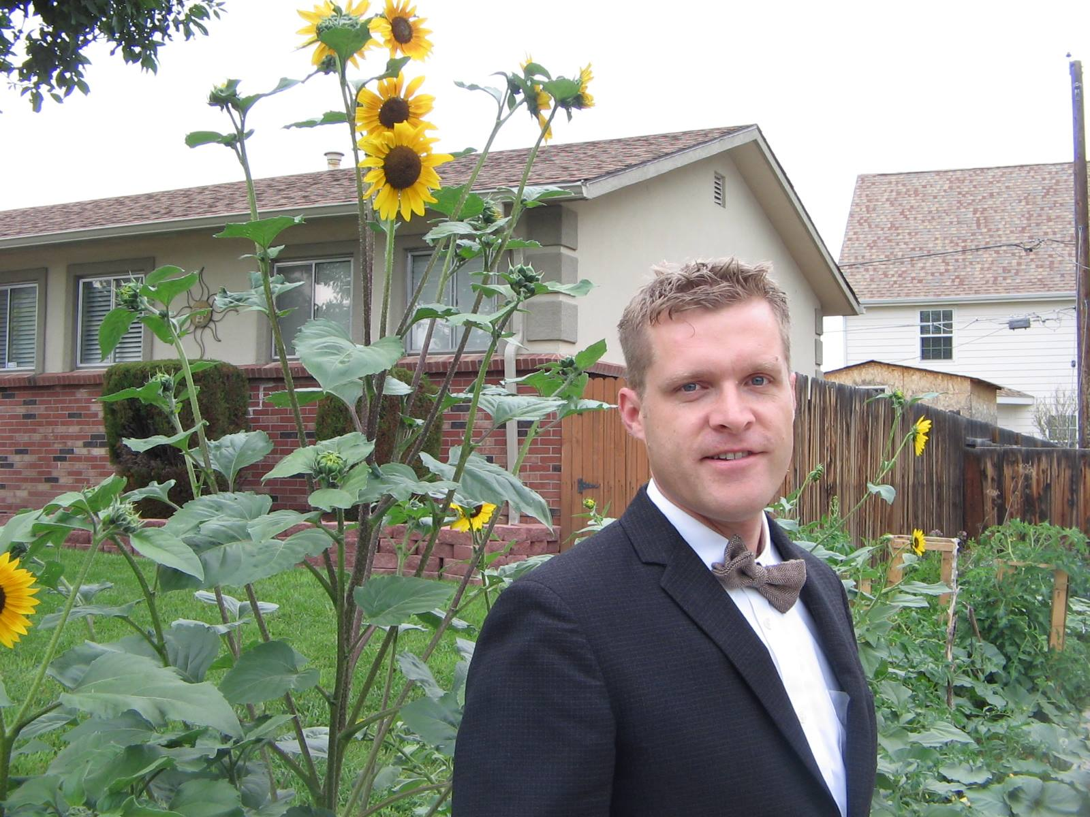
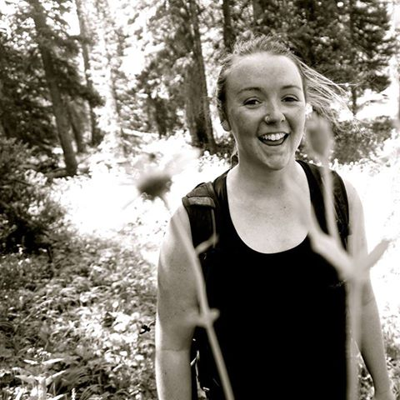

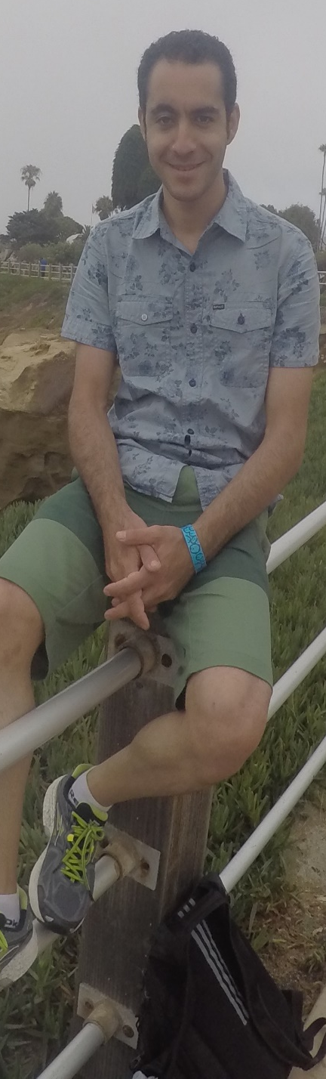
Acknowledgment

Slide 19
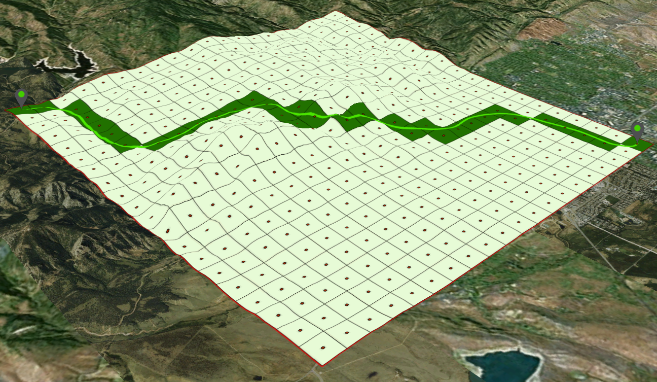
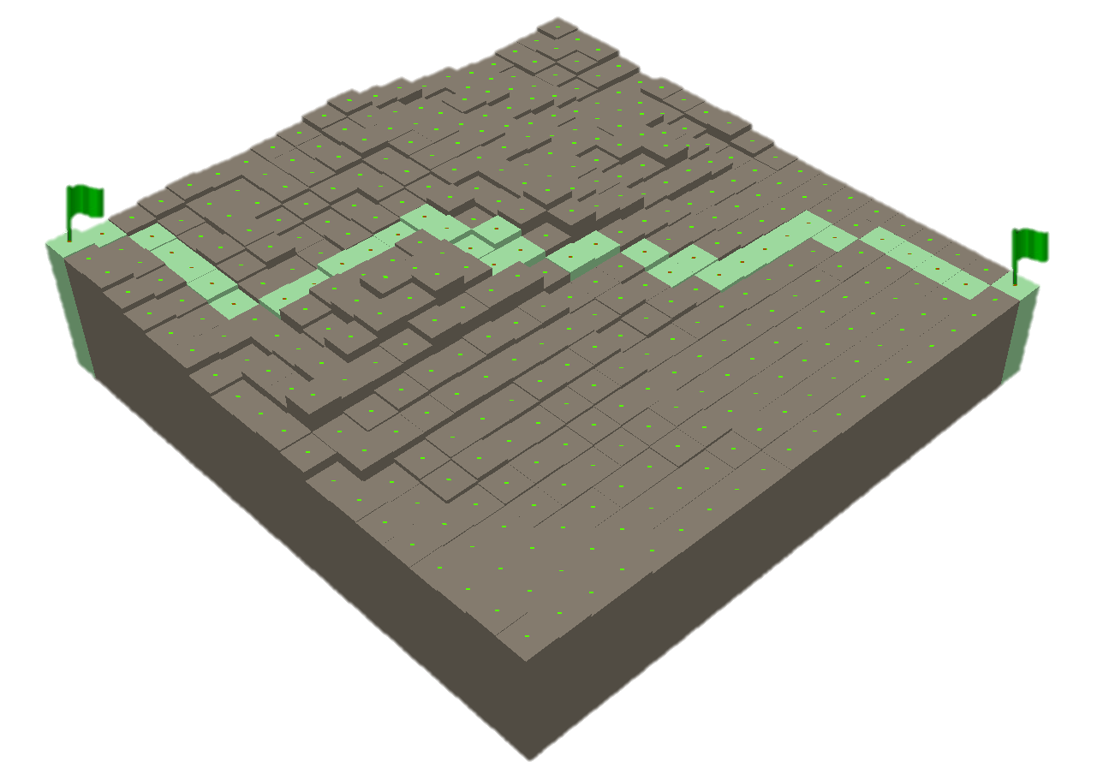
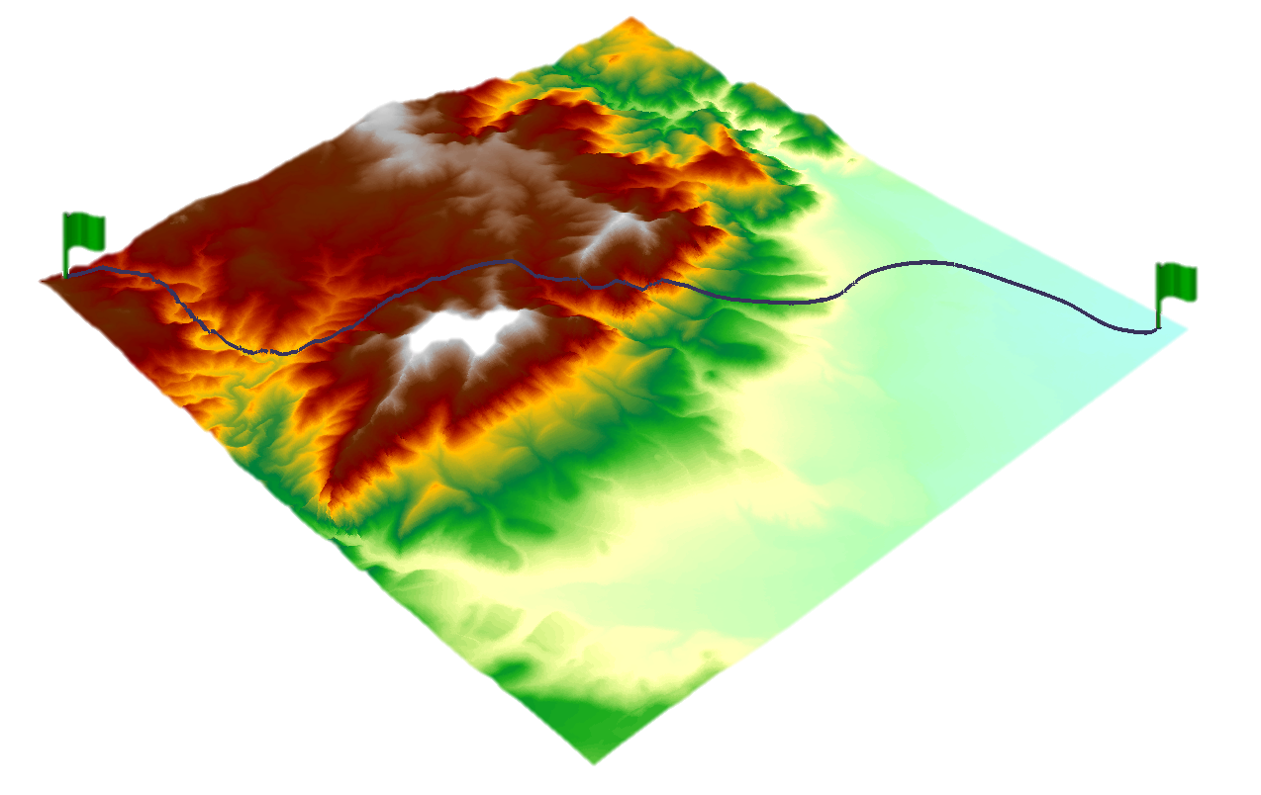
THANKS FOR YOUR ATTENTION
Everything is related to everything else, but near things are more related than distant things. (Waldo Tobler)

